Slide 1

CSE299 · SECTION 10 · TEAM NEXUS
Sprint 2 Weekly Project Review
Repository Setup, Branching Strategy & a Live CI/CD Pipeline
SPRINT SNAPSHOT
Window: July 13 – 21, 2026 | Status: Completed · 100% | Priority: High | Duration: 1 week, 1 day
Jihanur Rahman Ratul 2412800642
Team Lead — Repository, CI/CD & DevOps
Tahsin Ahmed Sufol
Code Review & Testing
Prepared for ITN Sir · CareerSetu — NSU Alumni-Industry Bridge Platform

Slide 2
PROJECT OVERVIEW
CareerSetu, at a Glance
CareerSetu is an AI-powered alumni–industry bridge platform for North South University — verified profiles, AI CV grooming, smart job matching, and scam-free hiring.
We’re two sprints into building the foundation: data collection is done, and as of this week our codebase has a real repository, a branching workflow, and an automated CI/CD pipeline behind it.
This report covers Sprint 2 (July 13–21) and previews Sprint 3, now underway.
SPRINT-BY-SPRINT STATUS
Sprint 1
100%
Completed
Jul 6 – 13
Data collection: NSU alumni & company datasets
Sprint 2
100%
Completed
Jul 13 – 21
Repository, branching strategy & CI/CD pipeline
Sprint 3
70%
In Progress
Jul 21 – 27
Front-end code for the alumni platform
CareerSetu | Sprint 2 Weekly Review | CSE299 Sec.10
02 / 14

Slide 3
SPRINT 2 · JULY 13 – 21, 2026
Sprint Goal & Key Deliverables
SPRINT OBJECTIVE
Create our project repository, have the team lead publish and own it, then push our code into it behind a valid CI/CD pipeline — with a sample app to prove the pipeline actually works.
KEY DELIVERABLES
A GitHub repository with a clear structure (app/, tests/, workflows/) and a defined governance model
A feature-branch + pull-request workflow so code lands on main safely
A GitHub Actions CI/CD pipeline that tests, builds and smoke-tests every change
A minimal FastAPI "sample app" to prove the pipeline end-to-end before real features are built on top of it
SPRINT META
Completed · 100%
High Priority
Tag: Dev
Tag: Design
Duration
1 week and 1 day
Owner
Jihanur Rahman Ratul (lead), reviewed with Tahsin Ahmed Sufol
CareerSetu | Sprint 2 Weekly Review | CSE299 Sec.10
03 / 14

Slide 4





WEEKLY PROGRESS
How the Week Unfolded
Jul 24
Jihan lays out the Week 2–3 plan in Slack: build a prototype web UI and stand up a CI/CD pipeline so publishing code and opening pull requests is automated.
Jul 26
Tahsin acknowledges and stays ready to contribute once the repository is live.
HOW WE TRACK PROGRESS
Slack (#299) handles day-to-day coordination and task hand-offs. The Notion Sprint Tracker is the source of truth for objectives, deliverables, completion % and retrospectives — reported here each week.
Aug 2–3
The repository, Dockerfile, sample FastAPI app and GitHub Actions workflow all land on main; the branching strategy is tested on a working branch before the first pull request.
Today
Jihan asks Tahsin to review main and open a PR for anything new — from here, the CI/CD pipeline tests and merges automatically once checks pass.
CareerSetu | Sprint 2 Weekly Review | CSE299 Sec.10
04 / 14

Slide 5
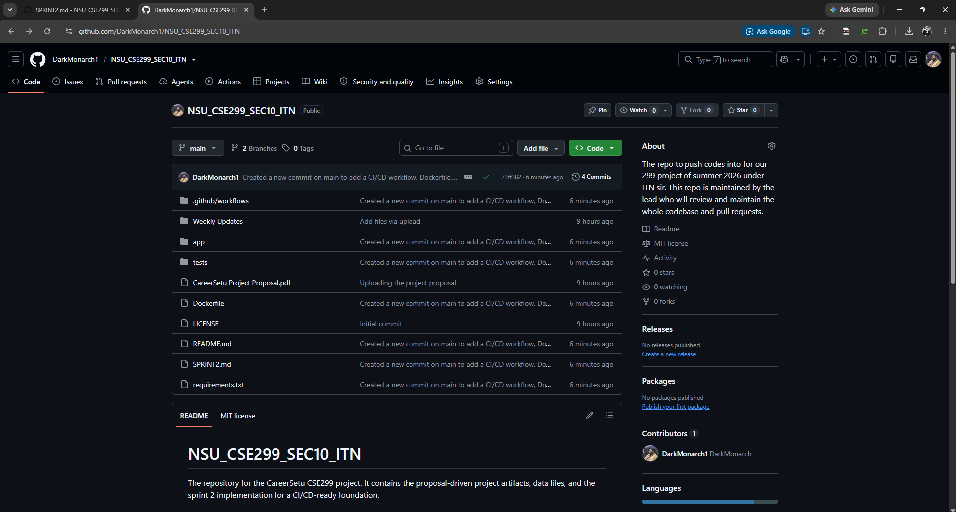
EVIDENCE · 1 OF 6
Repository Setup
Repo: DarkMonarch1 / NSU_CSE299_SEC10_ITN on GitHub, public
Structured into app/, tests/, and .github/workflows/, plus a README, MIT license, and the project proposal
The About section documents purpose and governance: the lead reviews and merges every pull request
A dedicated SPRINT2.md tracks this sprint’s implementation notes directly in-repo
github.com/DarkMonarch1/NSU_CSE299_SEC10_ITN
CareerSetu | Sprint 2 Weekly Review | CSE299 Sec.10
05 / 14

Slide 6
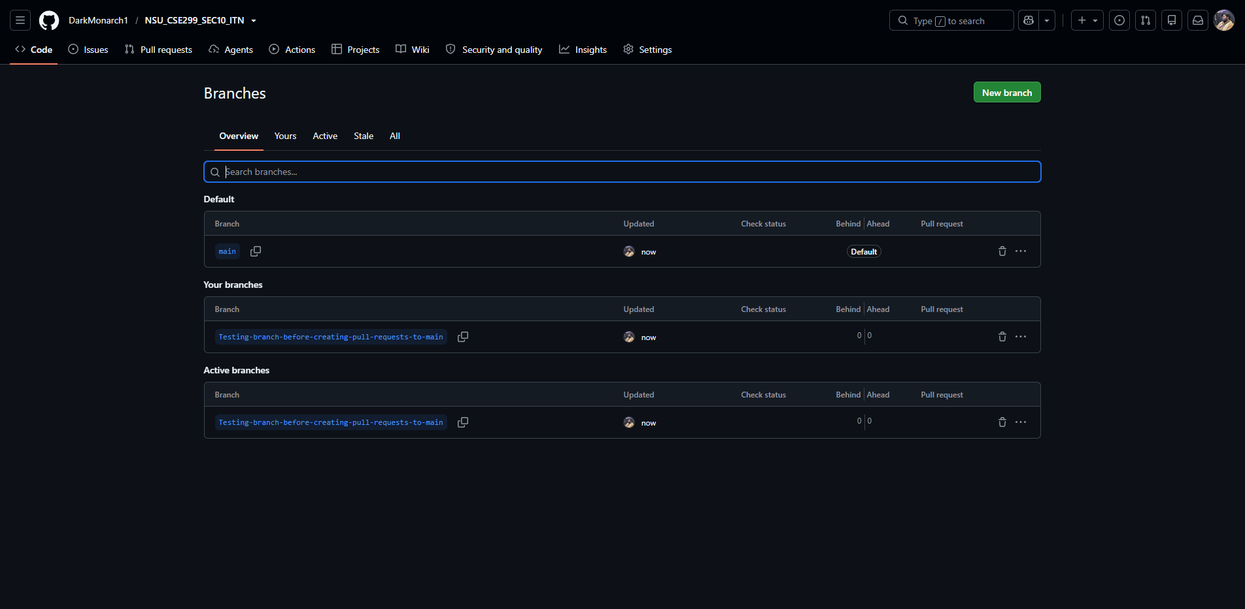
EVIDENCE · 2 OF 6
Git Workflow & Branching Strategy
main is the protected default branch
All work happens on a feature branch first — this sprint: Testing-branch-before-creating-pull-requests-to-main
Every change is proposed as a pull request rather than pushed directly to main
The new CI/CD pipeline runs automatically on every PR and merges once checks pass
github.com/.../NSU_CSE299_SEC10_ITN/branches
CareerSetu | Sprint 2 Weekly Review | CSE299 Sec.10
06 / 14

Slide 7
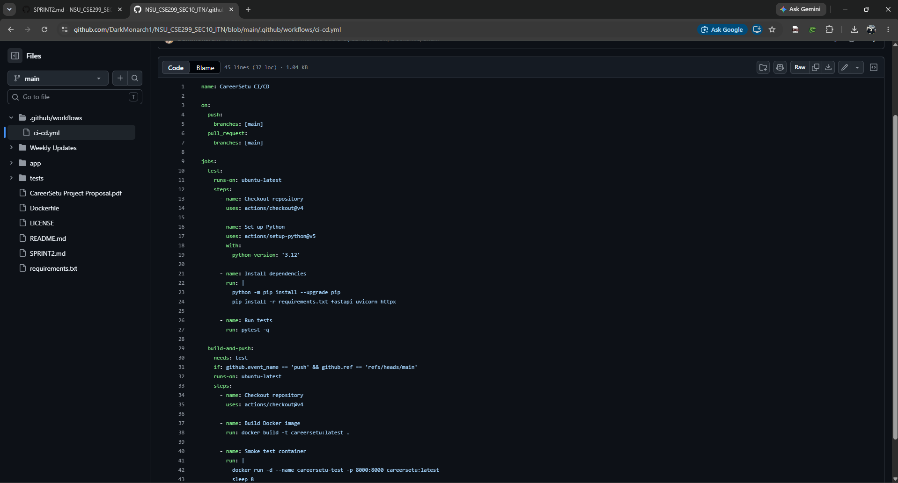
EVIDENCE · 3 OF 6
CI/CD Pipeline (GitHub Actions)
Triggers automatically on every push and pull request to main
test job: checks out the code, sets up Python 3.12, installs dependencies, then runs pytest
build-and-push job: runs after tests pass — builds the Docker image and smoke-tests the running container
Defined in .github/workflows/ci-cd.yml — 37 lines of YAML, fully version-controlled
.github/workflows/ci-cd.yml
CareerSetu | Sprint 2 Weekly Review | CSE299 Sec.10
07 / 14

Slide 8
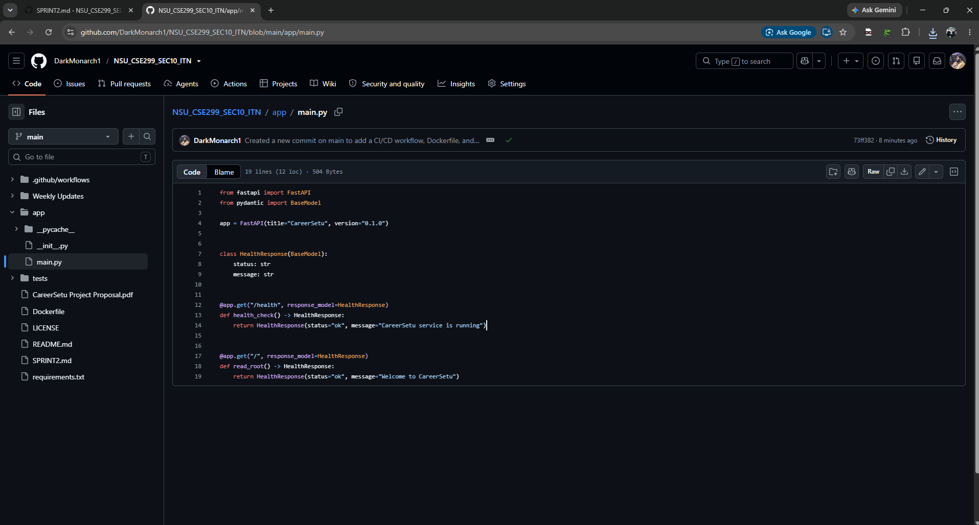
EVIDENCE · 4 OF 6
Demo — The Sample App
A minimal FastAPI service (app/main.py) built to prove the pipeline end-to-end
GET /health and GET / both return a typed HealthResponse (Pydantic model)
This is exactly what the CI/CD pipeline builds into a Docker image and smoke-tests automatically
Once this pattern is proven, real CareerSetu backend endpoints plug into the same pipeline
app/main.py
CareerSetu | Sprint 2 Weekly Review | CSE299 Sec.10
08 / 14

Slide 9
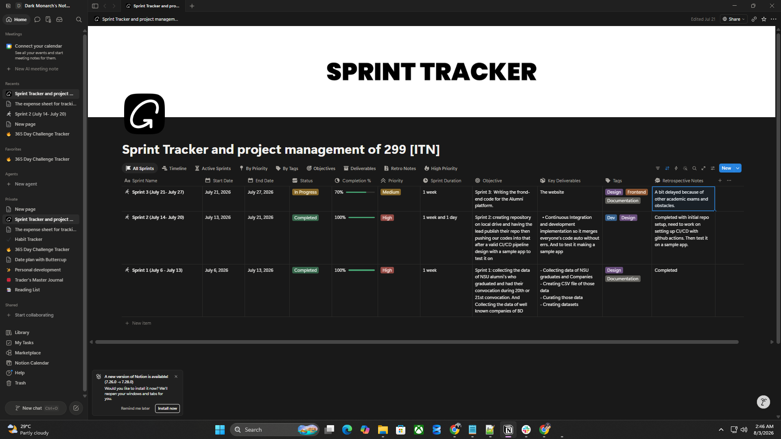
EVIDENCE · 5 OF 6
Sprint Tracking in Notion
Every sprint is logged with objective, key deliverables, tags, completion %, priority and retrospective notes
Sprint 2 is marked Completed at 100%, high priority, 1 week and 1 day duration
Retrospective notes stay honest — e.g. flagging that CI/CD setup needed to continue into this week
This table is the single source of truth this weekly report is built from
Notion — Sprint Tracker (299 [ITN])
CareerSetu | Sprint 2 Weekly Review | CSE299 Sec.10
09 / 14

Slide 10
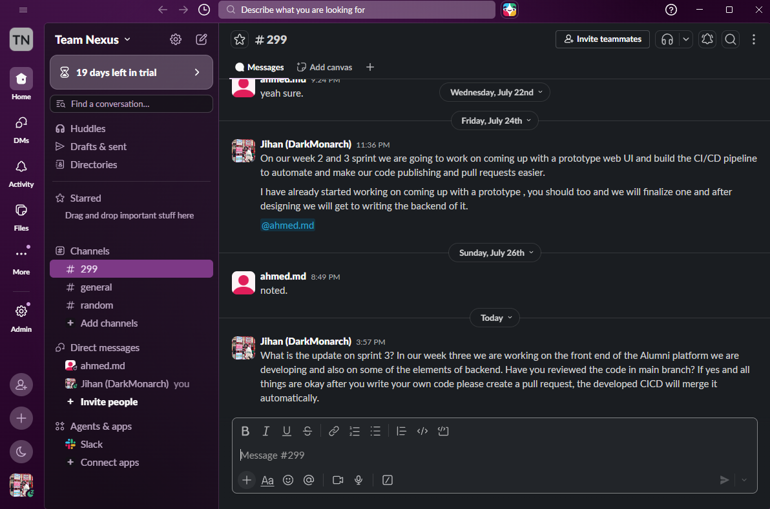
EVIDENCE · 6 OF 6
Communication Review — Slack
Team Nexus workspace, #299 channel — one running thread per week keeps history easy to review
Jul 24: Jihan lays out the Week 2–3 plan (prototype UI + CI/CD pipeline) and assigns next steps
Jul 26: Tahsin confirms and stays ready to pick up work once the repo is live
Today: Jihan confirms the pipeline is live and asks for a code review before the first PR into main
Slack — Team Nexus / #299
CareerSetu | Sprint 2 Weekly Review | CSE299 Sec.10
10 / 14

Slide 11
RISK MANAGEMENT
Risks & Issues
Risk | Likelihood | Impact | Mitigation
Two-person team vs. project scope | Medium | High | Strict per-sprint scoping and a lead-managed review cadence keep work unblocked
Only one contributor has merged to main so far | Medium | Medium | The new PR + CI/CD workflow brings the second contributor’s commits in starting Sprint 3
Academic exams overlapping sprint windows | High | Medium | Already surfaced in the Sprint 3 retrospective; buffer days added to upcoming sprints
Local vs. CI environment drift | Low | Medium | Docker containerization keeps local and pipeline environments identical
This section stays proactive rather than reactive — we track it every sprint so nothing here becomes a surprise.
CareerSetu | Sprint 2 Weekly Review | CSE299 Sec.10
11 / 14

Slide 12


RETROSPECTIVE
What Went Well, What We’re Improving
WENT WELL
TO IMPROVE
Repository scaffolded cleanly with a clear structure from day one
CI/CD pipeline is live, green, and fully automated
Docker containerization gives us environment parity for free
The sample app proved the whole pipeline end-to-end before real backend code touches it
CI/CD setup slipped to the end of the sprint — start pipeline work earlier next time
Only one contributor has merged so far — get the second contributor’s commits flowing via PRs immediately
100%
Sprint 2 completion — all four key deliverables shipped and verified on main.
CareerSetu | Sprint 2 Weekly Review | CSE299 Sec.10
12 / 14

Slide 13

LOOKING AHEAD · SPRINT 3
Next Sprint: July 21 – 27, 2026
SPRINT 3 OBJECTIVE
Writing the front-end code for the Alumni platform.
DELIVERABLE & META
Key Deliverable: The website (alumni platform front end)
Contributors: Jihanur Rahman Ratul & Tahsin Ahmed Sufol
Deadline: July 27, 2026
STATUS: 70% — IN PROGRESS
Sprint 3 has run a little behind schedule because of overlapping academic exams — the same obstacle already logged in our Notion retrospective. The team is aware and has added buffer days to the sprints ahead so this doesn’t compound.
Priority: Medium
Duration: 1 week
Tags: Design / Frontend / Docs
CareerSetu | Sprint 2 Weekly Review | CSE299 Sec.10
13 / 14

Slide 14

Thank You
We welcome your feedback, ITN Sir
SCORING RUBRIC & OPEN QUESTIONS
Is our Risks & Issues framing on the right track, and is the CI/CD pipeline at the level of rigor you expect for this stage of the project?
CSE299 · North South University · Section 10 · Team Nexus

